Slide 1
Spatial Organization
Gredhes Sierra
PSY/345
Dr. Phillip R Ludwig, Instructor

Slide 2
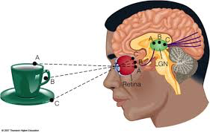
What is Spatial Organization?
Spatial Organization, refers to the way stimuli at specific locations in the environment are represented by activity at specific locations in the nervous system.

Slide 3
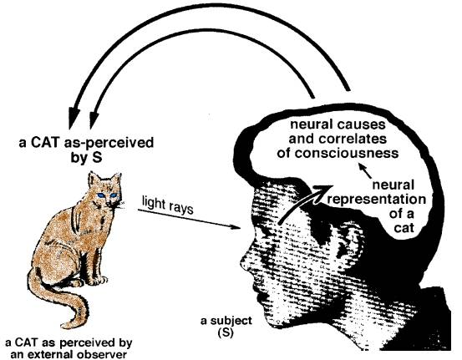
Concept of spatial organization
Notes:
When a person looks at an object, in this case the cat, the brain organizes the object through the visual field. The process of the organization starts in the visual space and is transformed and organized again in the eye.

Slide 4
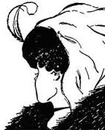
How spatial organization affects visual perception?
In the illustration on the right, some people will see a young woman. Some people will see an old lady. Visual perception depends on the signs, that we allow ourselves to see.
Notes:
Spatial organization have a positive effect on visual perception as it enables one to notice the differences in the groups in details for instance the size ,color or age. Visual perception is the way we see and interpret things.

Slide 5
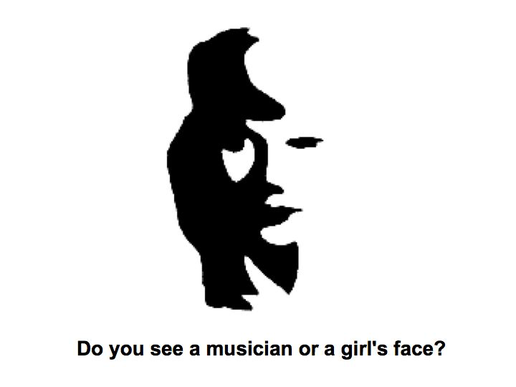
How spatial organization affects visual perception? Continued..
The visual system sometimes struggles to organize a stimulus, to figure out which of the features belong together.
Notes:
The visual system sometimes struggles (trying to gather) to perceptually organize a stimulus, to figure out which of the features belong together and which of them do not, resulting in an active percept, in which different groups compete against each other.

Slide 6
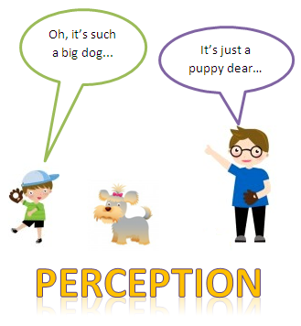
How perception influences behavior?
Notes:
In this picture above, we can see a kid and a old lady explaining their perception of the dog. The kid on the left perceives that is a big dog and feel scared. The lady on the right perceives that is a puppy and make her think that is adorable and not dangerous. Everyday, experiences shape the way we perceive things around us.

Slide 7
How perception influences behavior? Continued..
The perception that one develops towards a certain group, is likely to affect their feelings hence behavior towards it.
For instance if one perceives that a certain group has superior characteristics compared to others he/she is likely to be favoring the group hence developing discrimination.

Slide 8
References
Goldstein, E. B. (2014). Sensation and perception (9th ed.). Belmont, CA: Wadsworth.

